Slide 1

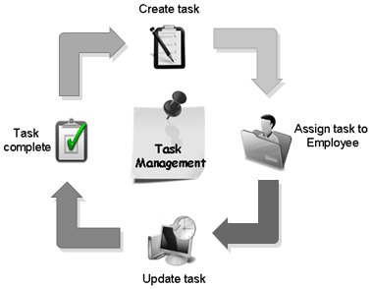
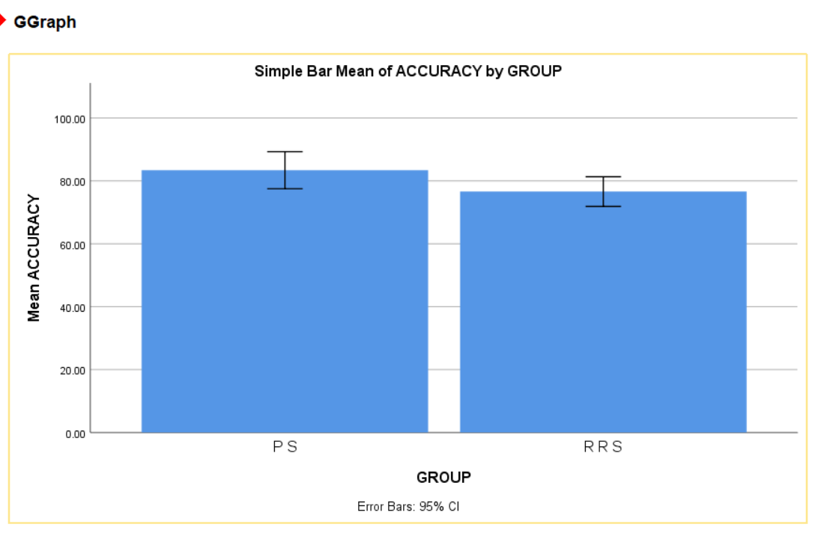
Name: Mr. V.VAMSI Register Number: 192212079
Guided by Dr. R.DINESH KUMAR
Ms. Poorani.S
Guided by Dr. Mary Valantina. G
Short time task management system for increasing productivity by using priority Scheduling Comparing with Round Robin Scheduling.
INTRODUCTION
The current priority scheduling system in your task management system. Describe how tasks are prioritized based on factors like urgency, importance, or other criteria.
Highlight the benefits and limitations of priority scheduling. For instance, while it ensures that high-priority tasks are completed promptly, it may lead to potential starvation of lower-priority tasks.
Define round-robin scheduling and how it differs from priority scheduling. Round-robin scheduling involves treating all tasks equally in terms of priority and allocating CPU time in a circular manner.
Explain the advantages of round-robin scheduling, such as fairness in CPU allocation and prevention of starvation.
Rovide a clear rationale for transitioning from priority scheduling to round-robin scheduling. This could include the need for fairer resource allocation, addressing issues of starvation, or improving overall system performance.
The plan for implementing round-robin scheduling. This may involve modifying the task scheduler in your system or implementing a new scheduling algorithm altogether.
Identify potential challenges or risks associated with the transition and develop mitigation strategies.
Provide training or documentation on how round-robin scheduling works and how it will impact users' interactions with the system.
MATERIALS AND METHODS
Execute till completion
Ready Queue
Execute for Time Quantum
Process Executed Completely
Burest Time Quantum Time
Termination
RESULTS
 | Algorithm | N | Mean | Std.Deviation | Std.Error Mean
Accuracy | Priority Scheduling | 10 | 83.4000 | 8.24891 | 2.60853
 | Round Robin Scheduling | 10 | 76.6000 | 6.58618 | 2.08273
In the present work, priority scheduling (PS) is compared with Round Robin Scheduling (RRS) and it depicts that the proposed algorithm gives more accuracy when compared with the priority scheduling. Round Robin Scheduling outperforms in priority scheduling in task management system by better handling binary outcome prediction and proving more accurate classification
DISCUSSION AND CONCLUSION
Based on T-test Statistical analysis, the significance value of p=0.001 (independent sample T - test p<0.05) is obtained and shows that there is a statistical significant difference between the group 1 and group 2.
Overall , the accuracy of the priority scheduling (PS) is 50.00 % and it is better than the other algorithm.
Round Robin Scheduling (RRS) - 45.00%
deadline scheduling (DS) - 33.00%
priority scheduling (PS) - 50.00%
first come first sreve (FCFS) - 45.00%
Earliest deadline first (EDF) - 35.12%
the transition process, careful planning, communication, and testing are essential to ensure a smooth and successful implementation. understanding of the rationale behind the transition are crucial for its acceptance and adoption.
By following a structured approach, including understanding the current system, introducing round-robin scheduling, planning and preparation, communication, testing, deployment, and ongoing evaluation and optimization, organizations can effectively make and maximizing the benefits for all users.
The Round Robin Scheduling is the priority scheduling less then of the deadline scheduling in format minimum benfits for all users in the community.
BIBLIOGRAPHY
J. A. Jeon, N. S. Kim, J. G. Go, T. J. Park, H. Y. Kang, and C. S. Pyo, “IoT devices product and technology trends,” Journal of the Korean Institute of Communication Sciences, vol. 31, no. 4, pp. 44-52, 2014.
J. H. Kang, H. J. Kim, and M. S. Jun, “Market and technical trends of internet of things,” Korea Contents Association Review, vol. 13, no. 1, pp. 14-17, 2015.
S. Husain, A. Prasad, A. Kunz, A. Papageorgiou, and J. S. Song, “Recent trends in standards related to the internet of things and machine-to-machine communications,” Journal of Information and Communication Convergence Engineering, vol. 12, no. 4, pp. 228-236, 2014.
Y. T. Lee, W. H. Hsiao, C. M. Huang, and S. C. T. Chou, “An integrated cloud-based smart home management system with community hierarchy,” IEEE Transactions on Consumer Electronics, vol. 62, no. 1, pp. 1-9, 2016.
X. Zeng, S. K. Garg, P. Strazdins, P. P. Jayaraman, D. Georgakopoulos, and R. Ranjan, “IOTSim: a simulator for analysing IoT applications,” Journal of Systems Architecture, vol. 72, pp. 93-107, 2017.
S. Zhao, L. Yu, and B. Cheng, “An event-driven service provisioning mechanism for IoT (internet of things) system interaction,” IEEE Access, vol. 4, pp. 5038-5051, 2016.
W. Lee, S. Cho, P. Chu, H. Vu, S. Helal, W. Song, Y. S. Jeong, and K. Cho, “Automatic agent generation for IoT-based smart house simulator,” Neurocomputing, vol. 209, pp. 14-24, 2016.
Singh, R. 2003. RCal: An autonomous agent for intelligent distributed meeting scheduling. In Technical Report CMU-RI-TR-03-46, Robotics Institute. Carnegie Mellon University, Pittsburgh, PA.

